Slide 1
America’s $10 Billion Overspend on Sofosbuvir-Based Hepatitis C Treatment Resulting from Unmerited Patents
Pattillo, A., Fortunak J., Ravicher, D., Hughey, MH., Amin, T., Krishtel, PR.
Initiative for medicines, access, & knowledge (i-mak)
Notes:
Good afternoon. Pleased to be here to present some of our recent work on treatment cost and access
IMAK is a U.S.-based nonprofit who’s mission to make sure ppl around the world get access to essential medicines by ensuring integrity in the patent system
Typically we have been a small team of scientists & lawyers. In 2017 we added market dynamics & research investigation (that I head) … to inform our interface with real-world markets and to help quantify the potential impact of our legal interventions
We see our work in this area as a key tool to help civil society affect change and measure impact

Slide 2
background
About 1/4 of the est. 1.2m HIV+ people in the U.S. are also co-infected with HCV
SOF-based meds represent nearly 2/3 of all DAA scripts written in the U.S., and effective cure for 95% of patients
The high price of non-generic SOF meds has resulted in rationing by payers and limited access for patients
Globally, only 3 of 71m HCV+ have received DAA treatment
Worldwide, many of the patents on sofosbuvir have been identified as unmerited and overturned or not granted – e.g. Argentina, Brazil, China, and Ukraine
Investigate patent price access
linkage
for SOF
in the U.S.
Notes:
A bit of background as to how we landed on this issue:
1, 2, 3, 4, 5
The combinatoin of these factors that led us to want to dig deeper and “investigate the patent / price / access linkage …”

Slide 3
methods
Comprehensive examination the patent portfolio of sofosbuvir
Analyzed the commercial market dynamics for SOF-based products and modeled annual spending for branded vs. generic product
Assessed the current landscape of patient access to HCV medicines in the U.S.
Notes:
Briefly, there were three main efforts behind our analysis:
Examined *full*patent portfolio of SOF, extending beyond just Orange Book patents to include all issued patents and all currently pending patent applications
We built annual revenue models that extrapolated pricing and competitive dynamics from *real-world* market conditions in attempt to assess total costs for various scenarios of accelerated generic product entry, as compared to branded SOF.
Lastly, we used pharma-reported treatment figures and CDC estimates to get a snapshot of current patient access – e.g. how many ppl are getting treated or NOT.

Slide 4
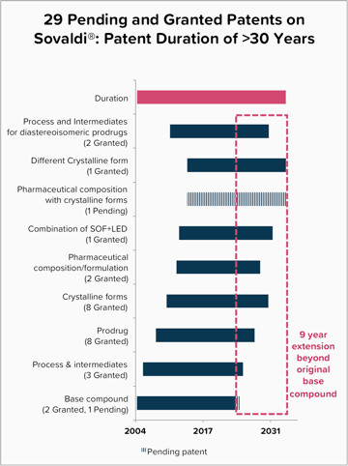
finding #1: patents
Nearly all of the patents on Sovaldi® are secondary patents distinct from the base compound sofosbuvir.
These have extended the effective patent duration by 9 years from the base compound and 30yrs total (& continuing to file)
Many of these patents have been invalidated in other countries - e.g. Argentina, Brazil, China, and Ukraine
Notes:
Our first key finding is that nearly all the U.S. patents on SOF – 26 of 29 granted patents -- are secondary or follow-on patents, distinct from the base compound
These granted secondary patents – on various salt or crystalline forms of drug intermediates, or process used to generate them -- have extended the patent lifespan of SOF by 9 years from the time when the base compound is set to expire and, when patent *applications* are considered, the total patent lifespan is in excess of 30 years … well beyond the standard 20yr patent time
It’s many of these granted secondary patents that have been invalidated or not issued in a number of key middle income countries, including Arg, Brazil, China and Ukraine

Slide 5
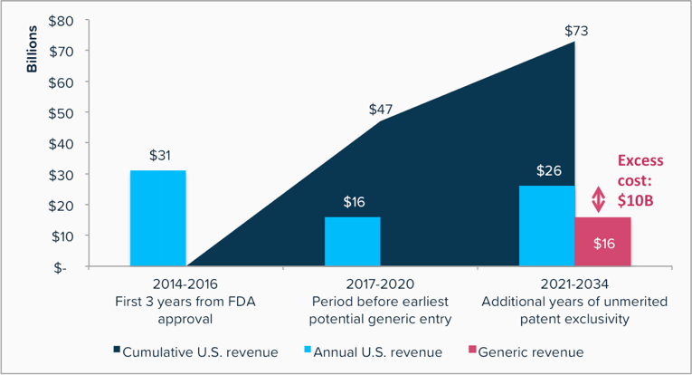
finding #2: costs
U.S. payers are projected to spend an excess of $10 billion for branded SOF-based products in 2021-34 as compared to treatment costs with generic sofosbuvir.
Notes:
Our second key finding is that $10 billion in excess costs is projected to be spent by U.S. payers for branded SOF, as compared to Tx regimen that would be available with generic SOF (namely a SOF/Daclatisvir combination)
The period we identified, from ‘21 to ’34, reflects the earliest potential time a generic SOF could enter the U.S. market (pending legal challenges) -- and through the point in which the patent on the branded product would otherwise expire.
Gilead would earn $26b in that period, $10b more than estimated costs for Tx regimens that would use generic SOF
(Also worth noting that Gilead is projected to earn a cumulative total of $73 B on its HCV franchise over this total timeframe)

Slide 6
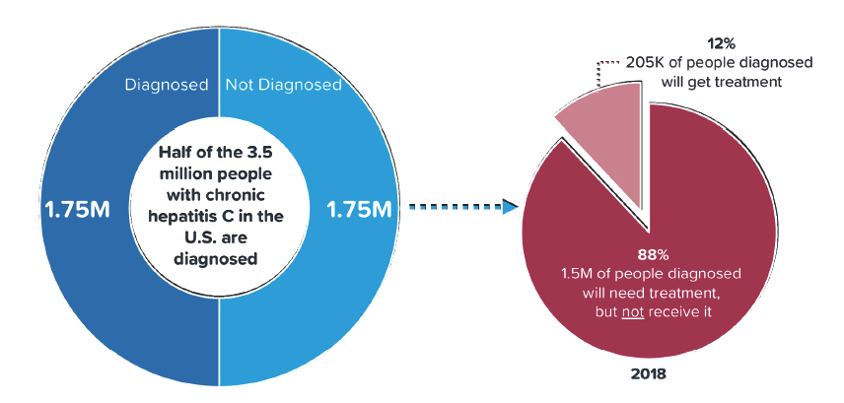
finding #3: access
Over 85% of diagnosed HCV patients in the U.S. will not get access to treatment in the coming year.
Notes:
Our 3rd key finding is that, of all HCV patients in the U.S. who are *already diagnosed* (that’s approx half of the total 3.5m chronic HCV population), over 85% are not expected to receive treatment this year
This is based on historical rates of total DAA treatment initiation observed, that peaked in 2016 and have been decreasing since, (even in light of decreasing Tx costs)

Slide 7
conclusion
Unmerited secondary patents have been identified on Sovaldi® resulting in prolonged exclusivity periods that a) prevent generic product entry, b) burden payers with billions in overspend, and c) generate significant access problems for HCV patients in the U.S.
01 | 01 | 2018
Notes:
Just read slide!

